Slide 1
FAKE NEWS DETECTION

Slide 2
PROBLEM STATEMENT
Fake news is a widely disseminated source of great worry due to its potential to create significant social harm. Our goal is to employ Machine Learning models to figure out whether or not the news is fake.

Slide 3
MODULES
Data Preprocessing
Dataset Description
Algorithms Implemented
Results and Insights
Problems faced
Future Scope

Slide 4
PREPROCESSING
Removing Stop Words
Removing Unnecessary Characters
Tokenization
Encoding
Feature Scaling

Slide 5
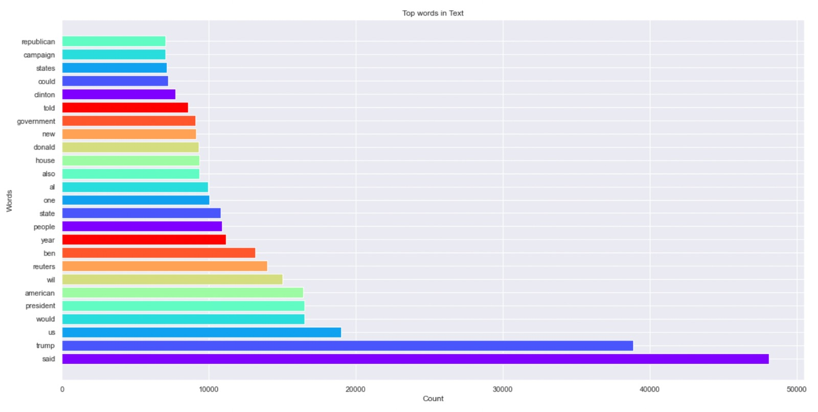
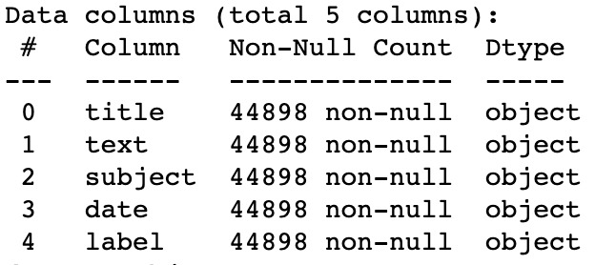
DATASET DESCRIPTION
Summary of the data after preprocessing
Top words used in the dataset

Slide 6
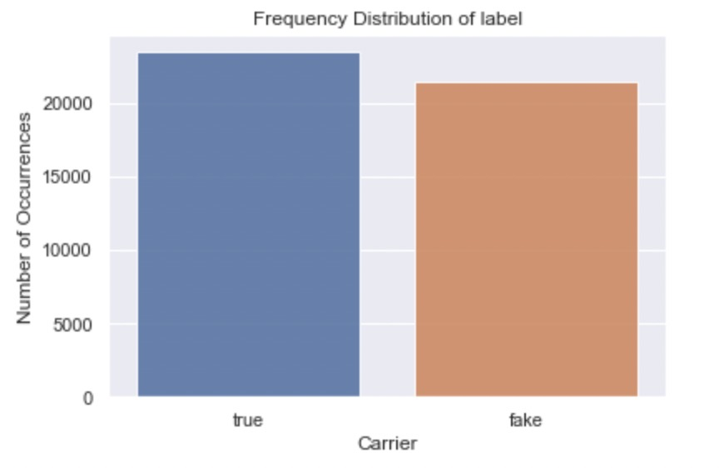
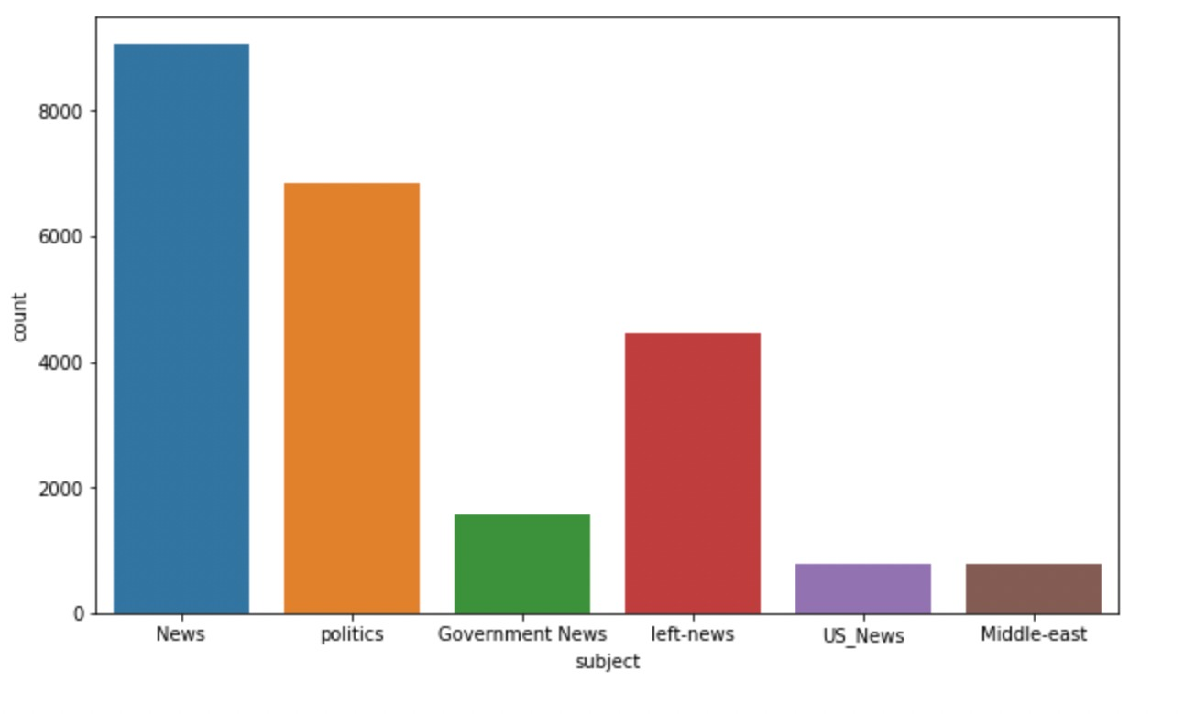
DATASET DESCRIPTION
Frequency distribution of subject column
Frequency distribution of label column

Slide 7
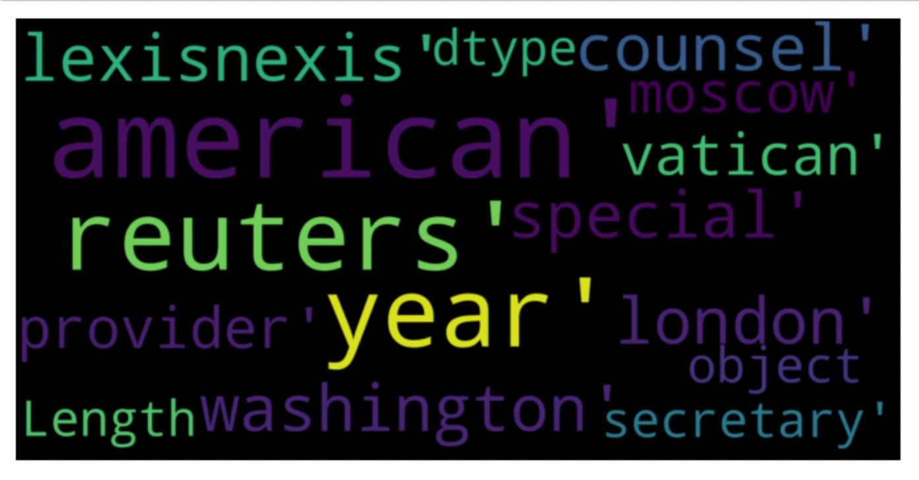
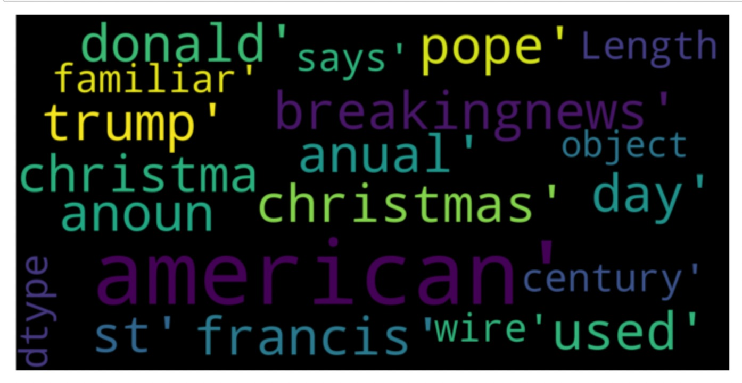
DATASET DESCRIPTION
Word cloud of fake news
Word cloud of real news

Slide 8
ALGORITHMS IMPLEMENTED
Single classifier based prediction:
Support Vector machine - 79.9%
Naive bayes classifier - 73.15%
Logistic Regression - 79.97%

Slide 9
ALGORITHMS IMPLEMENTED
Ensemble Approach based Classifiers
Random Forest Classifier - 79.91%
Voting Classifier - 79.7%
Gradient Boosting Classifier - 80%

Slide 10
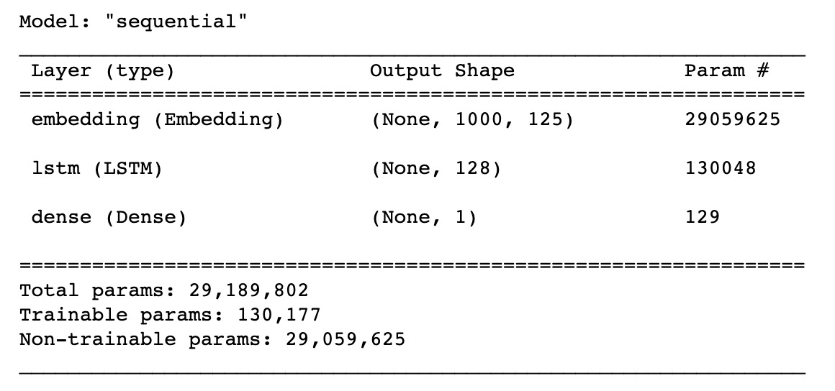
ALGORITHMS IMPLEMENTED
RNN(LSTM) – 99.6%
Catboost Classifier – 99.7%
LSTM

Slide 11
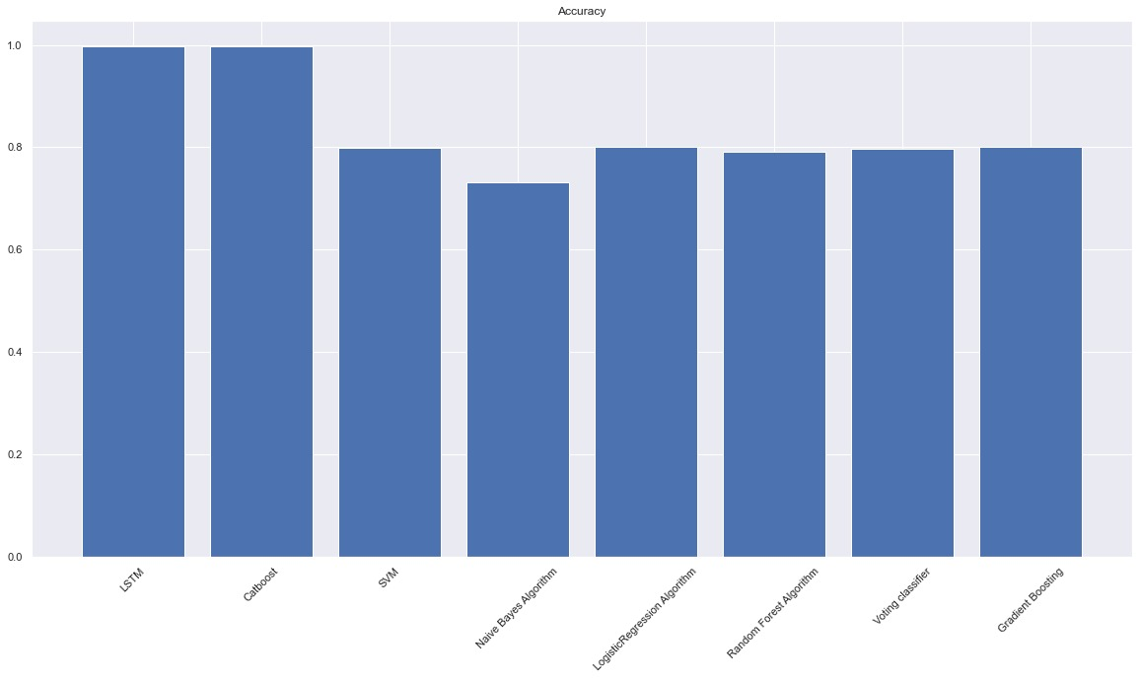
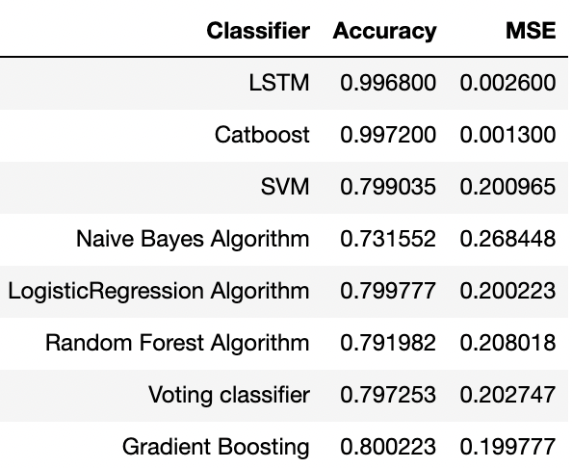
RESULTS AND INSIGHTS
Accuracies and Root Mean Squared Errors of different models
Comparison plot of accuracies

Slide 12
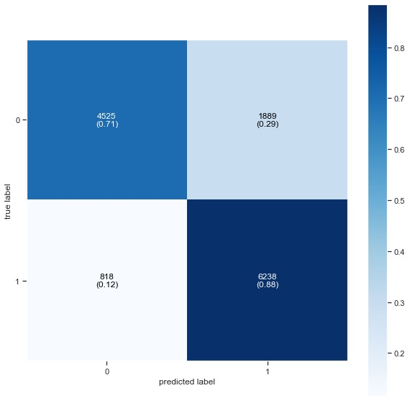
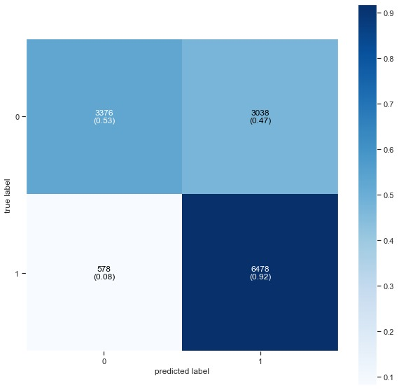

RESULTS AND INSIGHTS
Support Vector Machine Confusion Matrix
Naive Bayes Confusion Matrix
Linear Regression Confusion Matrix

Slide 13
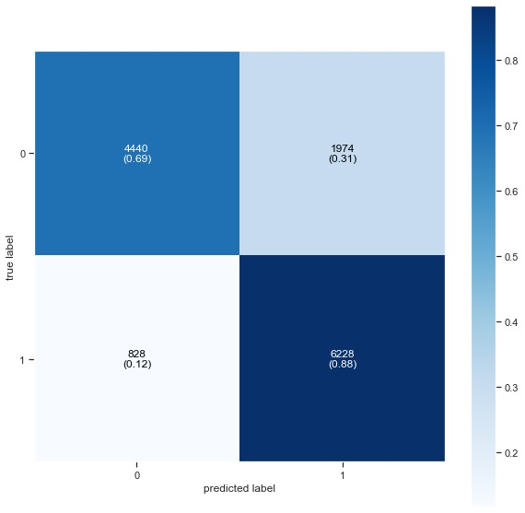
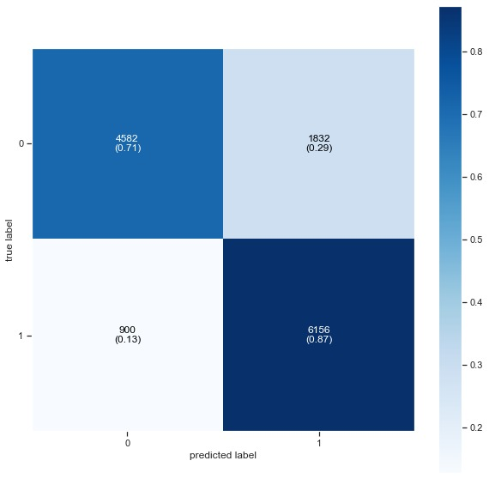
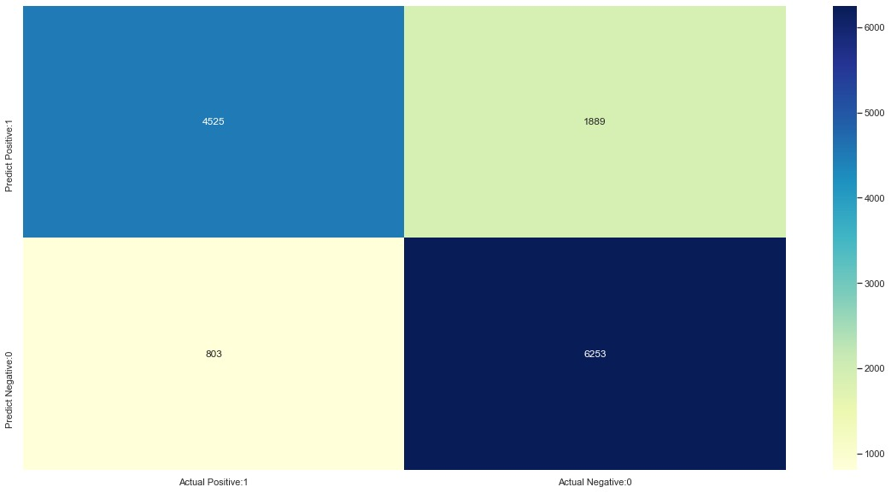
RESULTS AND INSIGHTS
Confusion matrix for Random Forest Classifier
Confusion matrix for Voting Classifier
Confusion matrix for Gradient Boosting.

Slide 14
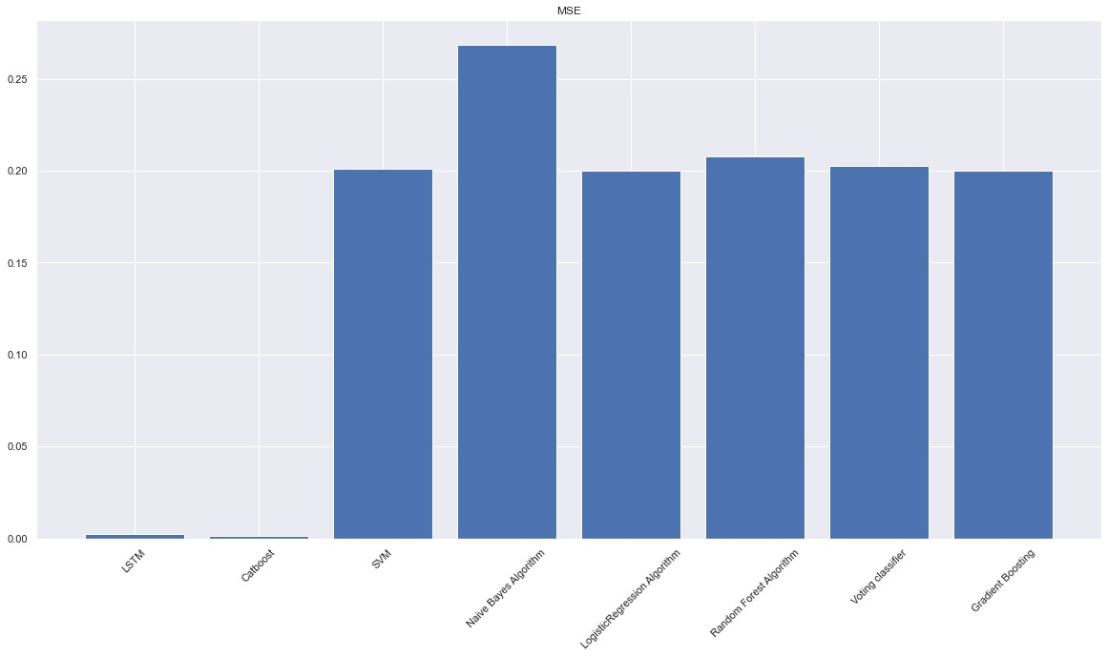
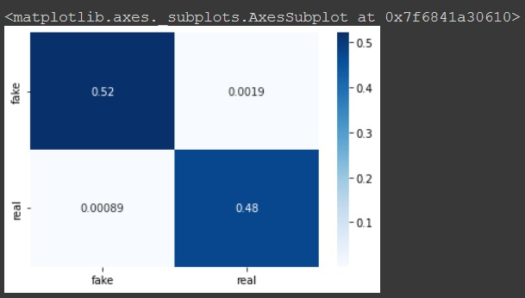
RESULTS AND INSIGHTS
Confusion Matrix for Catboost Classifier
Root mean square errors comparison plot

Slide 15
PROBLEMS FACED
Sub-power Accuracy
Preprocessing

Slide 16
FUTURE SCOPE
Implement a hybrid model with both text and image data (Fakeddit)

Slide 17
THANK YOU

